Slide 1
COM 141/LEC/16 Communication and Academic Literacy Skills for Science
Dr Richmond Ngula
CSSU, University of Botswana
Email: ngular@ub.ac.bw
Office: Block 229; R115

Slide 2
COURSE TITLE AND DESCRIPTION
Title:
Communication and Academic Literacy for Science
Description:
The course introduces science students to the concepts of communication, academic and information literacy skills. It begins with the idea, processes and barriers of communication, and then goes on to focus on academic literacy skills that aim to make the student an autonomous learner. We will cover topics such as the ability to listen effectively, to take down or make notes, to make an effective oral presentation, to read effectively and to write in a scientific manner.

Slide 3
COURSE OBJECTIVES
apply the language skills of speaking, writing, reading, and listening in all academic communication contexts relevant to the science discipline
apply principles of communication to both academic and social situations
select an appropriate medium to communicate ideas
use information literacy skills for scientific research
develop and apply critical thinking skills in different situations
write academic texts that are fluent, accurate and appropriate to the scientific discipline
use information technology to enhance the students’ communication skills

Slide 4
Understanding Human Communication
Can you imagine your life without communication?
Does being alone even suggests that no communication takes place?
Communication shapes and get shaped by human relationships.
Defining communication
We may define communication by reflecting on the original Latin meaning of the word: ‘communicare’, meaning ‘to share’.
Thus communication is the ‘sharing’ of information between two or more individuals or a group to reach a common understanding.

Slide 5
Understanding Human Communication
But ‘information sharing’ may be just the primary function of communication; it serves several other needs as we relate with other people and with ourselves:
Physical needs – communication helps us maintain physical and mental well-being.
Relational needs – communication helps us form social and personal relationships.
Identity needs – communication helps us decide who we are and who we want to be.
Ideological or spiritual needs – communication lets us share our beliefs and values with others.
Instrumental needs – communication helps us accomplish many day-to-day tasks.

Slide 6
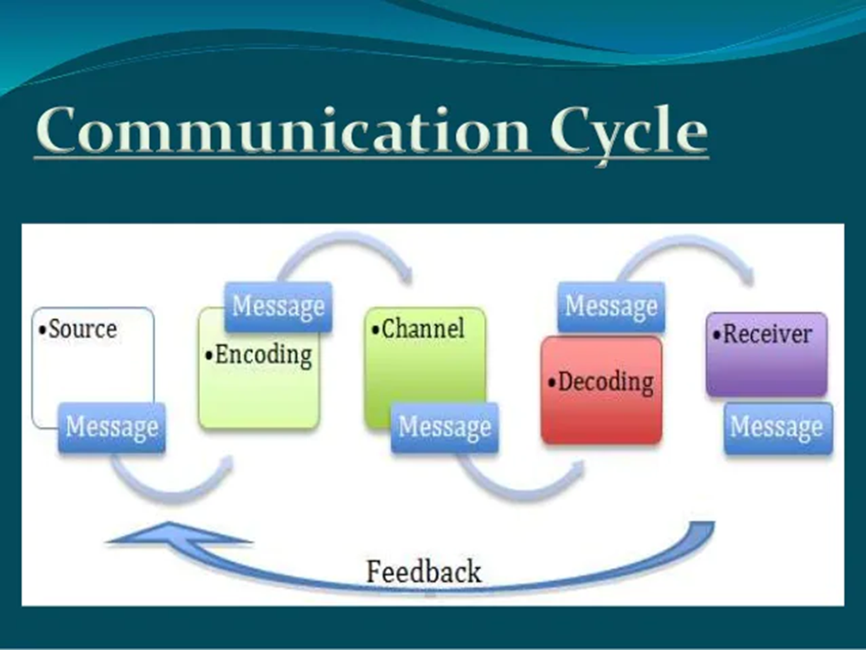
Elements of Communication
Exchange of information involves
giving information – productive skills (speaking and writing)
receiving information – receptive skills (listening and reading)

Slide 7
Modes of Communication
Verbal (linguistic modes – spoken or written): any types?
Non-verbal (no words or language – para linguistic modes: facial expression, gesture, eye contact, body posture, movement, touch, etc.)
Visual (the use of images, pictures): examples, traffic lights, sign for slippery surface, road signs, images in ads, etc.
To what extent do these work independently of each other or collectively in a single communicative event?

Slide 8
Effective Communication
Effective communication happens when people involved in the communication achieve shared understanding and meaning of messages.
Apply basic principles of communication skills for effective communication – 7 Cs:
clear – be clear about what you want to say or write.
concise – use simple words and say only what is needed.
concrete – use exact words, phrases, and use facts and figures.
correct – use correct spellings, language and grammar
coherent – your words should make sense and be related to the main topic of discussion.
complete – your message should have all the needed information.
courteous – be respectful, friendly and honest.

Slide 9
Barriers of Effective Communication
A barrier to interpersonal communication is anything that prevents, restricts or impedes the sharing and understanding of messages between and among the interactants.
Barriers
language too many questions and arguments discomfort with the topic lack of interest emotions and attitudes prejudice | noise physical distractions culture disability past experience time and space

Slide 10
Barriers of Effective Communication
Working in pairs, discuss how any one of points listed on the previous slide acts as a barrier to effective communication.
In the same pair, explain how that barrier to communication can be overcome.

Slide 11
Communicating in the University Setting
It’s a new communication environment.
You will engage in ‘social’, ‘administrative’ and, most importantly, ‘academic’ communication.
The academic community requires you to be able to communicate in effective and proficient ways, especially with regards to academic communicative styles. One of our main aims in this course, therefore, is to introduce you to academic communicative skills in your discipline.
Key communicative/language skills to develop: listening, reading, speaking, writing, and critical thinking.

Slide 12
Communicating in the University Setting
Communication text types (genres) you will be encountering.
Spoken texts
lectures,
in-class presentations,
group discussions,
seminar presentations,
lecturer-student advisory sessions, etc.
Written texts
textbooks
research monographs/books
research articles
technical reports
student essays
case evaluations
student (mini) research projects, etc.

